Slide 1
BTP - Smart Bin
Ali Jafri - 2013CSB1030
Pradeep Kumawat - 2013CSB1021
Rehmat Aulakh - 2013CSB1027
Notes:
Get some hints from our Mid Sem Poster

Slide 2
Introduction
Waste segregation is not only an environmentally pressing issue, it is an economic necessity as well. With the rapid generation of wastes we are fast running out of sites for landfills.
A smart bin is a bin that comes with the ability to indicate that it needs to be emptied whenever it reaches a certain threshold.
Notes:
The problem
What’s a smart bin?

Slide 3
Literature Survey

Slide 4
IoT-Based Smart Garbage System for Efficient Food Waste Management- Insung Hong, et al
Their approach was based on a weight measurement strategy so, when a resident wishes to dump his waste he uses an RFID card to discharge his food waste, his personal card information registered on the RFID card is transferred to the charge management server,which then requests the card company to process the payment depending on weight.
Base Rate + (Waste Emission𝐶/Waste Emission𝑃)× Past Changeable Rate = Next Month Rate
Next Month Rate − Base Rate = Past Changeable Rate. [I]

Slide 5
IOT Based Intelligent Bin for Smart Cities - Meghana K C, et al
For garbage detection, many sensors like weight sensors, IR sensors, etc can be used.
Since, using weight sensor is inefficient because it doesn’t identify the level of waste in the bin (density).
A properly covered IR sensor is used, if the threshold level is reached the following information is extracted garbage level, bin location, date and time of event.
Respective person informed to clean the bin as soon as possible via auto-generated message. [II]

Slide 6
IoT Based Smart Garbage and Waste Collection Bin -S.S.Navghane, et al
They use a combination of sensors namely weight sensor and IR sensor to indicate its weight and different levels respectively. They send their output ahead when the designated threshold level is crossed.
Details of this are programmed in the microcontroller (ARM LPC2148) and the controller gives the details to the transmitter module (Wifi module), details of the garbage bin are displayed onto the HTML page in web browser of mobile handset connected to the router [III]

Slide 7
How does our
smart bin look?

Slide 8
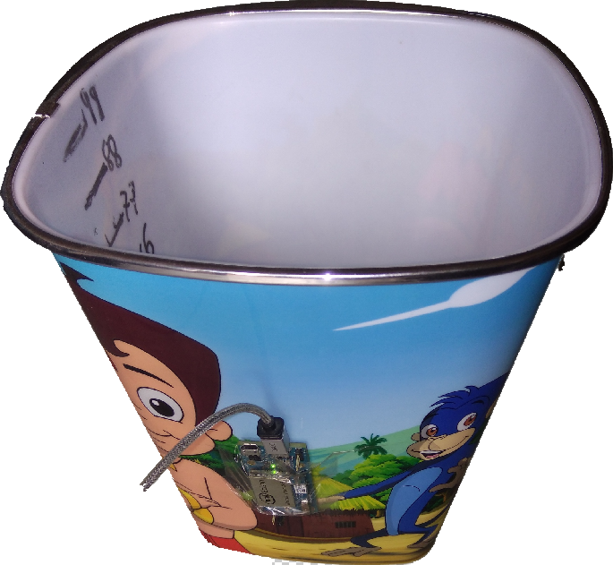
Smart Bin - Prototype
Notes:
While displaying this we would show them our bin, actual real bin on the spot. That would give us an advantage

Slide 9
What does it comprise of?

Slide 10
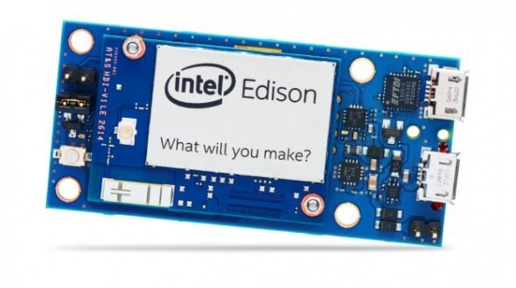
Smart Bin - Components
Intel Edison (WiFi Module)
A Bin
A pair of USB cable
Garbage*
Notes:
Now we can elaborate a little on what is intel edison and other stuff

Slide 11
What is
Intel Edison?

Slide 12
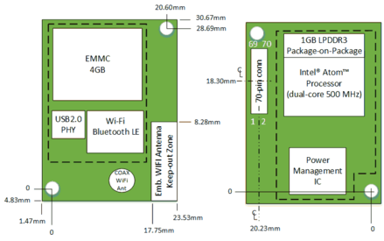
Intel Edison - brief
The Intel Edison is a tiny computer-on-module offered by Intel as a development system for Internet of Things devices.

Slide 13
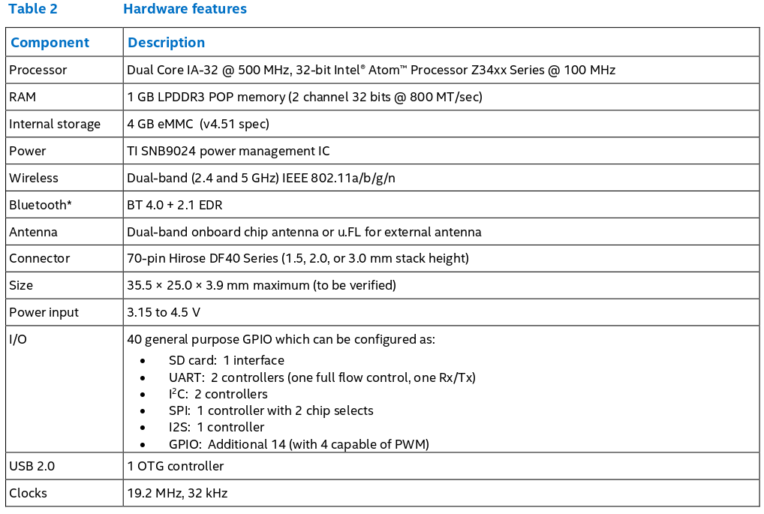

Slide 14
The Methodology?

Slide 15
Methodology
Two Intel Edison were attached outside the bin opposite to each other as shown in the prototype at a height of 33% from below.
The function of one Intel Edison was that of a wifi hotspot while that of the other was to connect to that hotspot.
The main motive of this setup was to analyze the effect on strength of signal due to various substances inside bin which may interfere with the signal.

Slide 16
Methodology...
We collected as much data as we could with substances like Water, Sweet Lemon (mosambi), Clothes, Paper, and random stuff.
The height of bin filled was to be predicted* and the category of substance inside using the variation in signal strength.

Slide 17
What were our substances?

Slide 18

Water

Slide 19
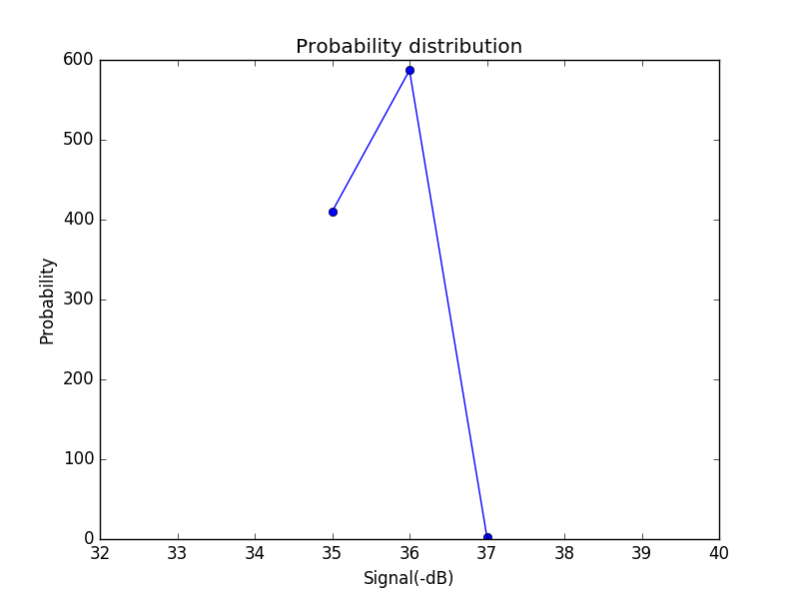
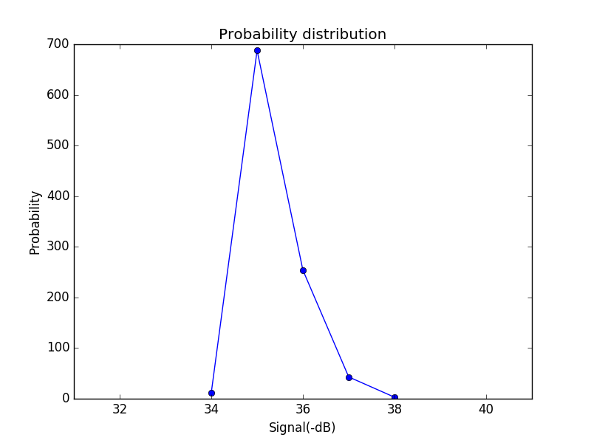
Empty
11%

Slide 20
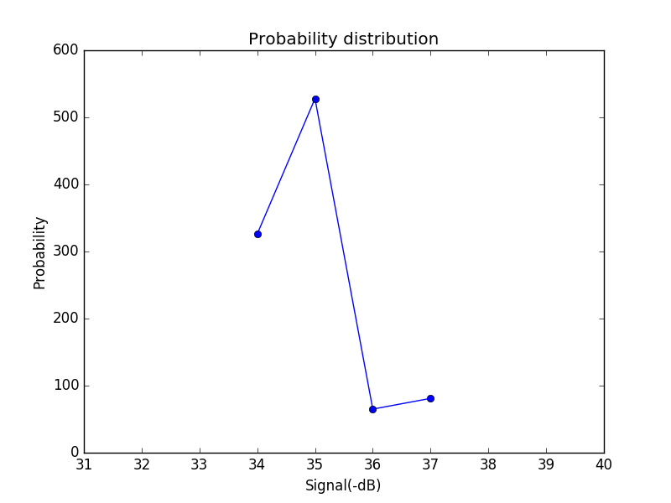
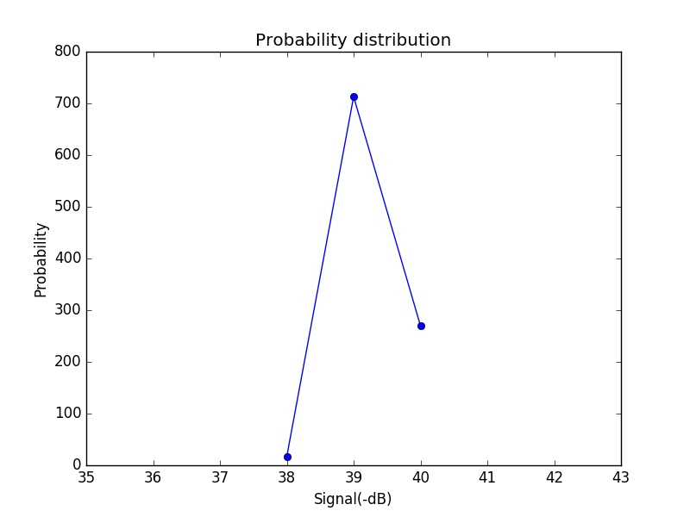
22%
33%

Slide 21
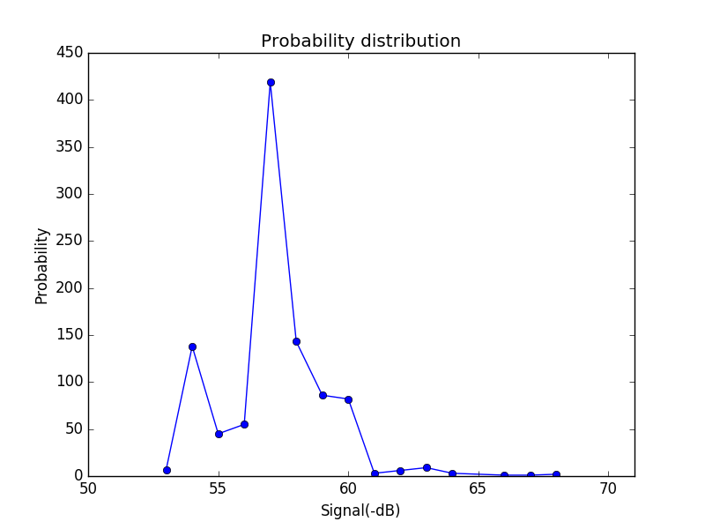
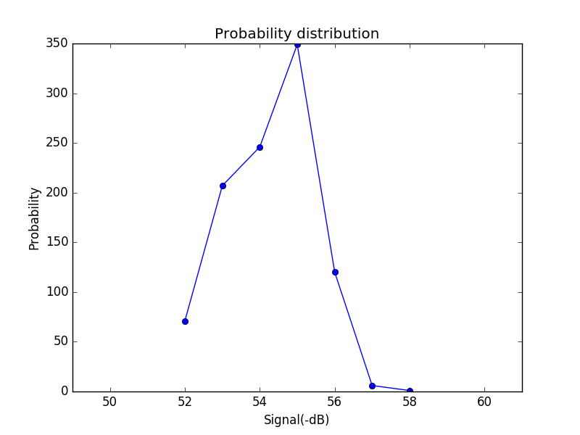
44%
55%

Slide 22
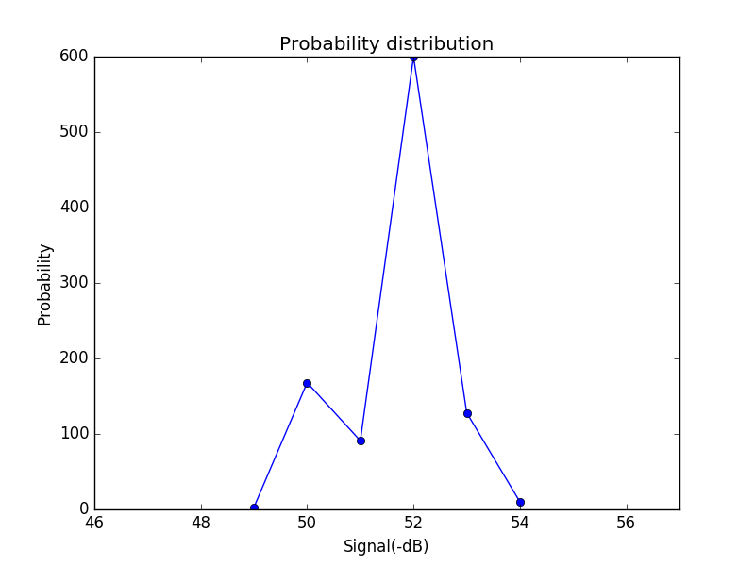
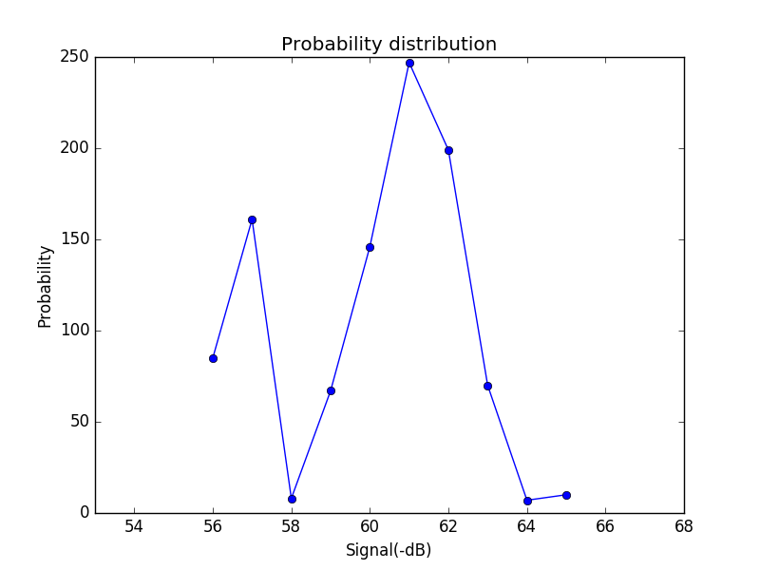
66%
77%

Slide 23
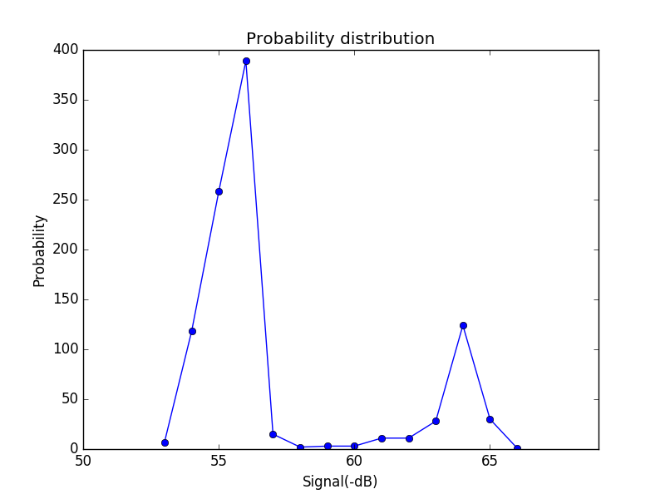
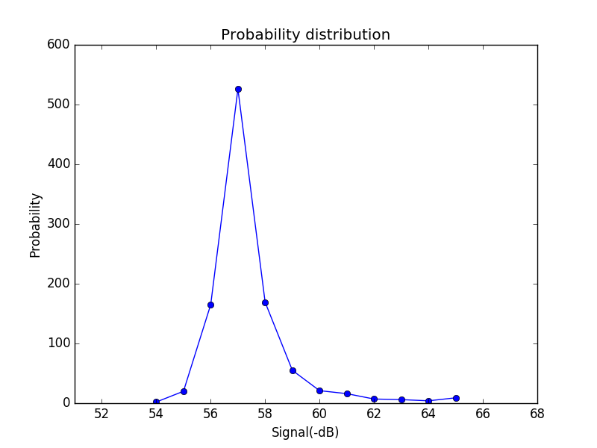
88%
99%

Slide 24
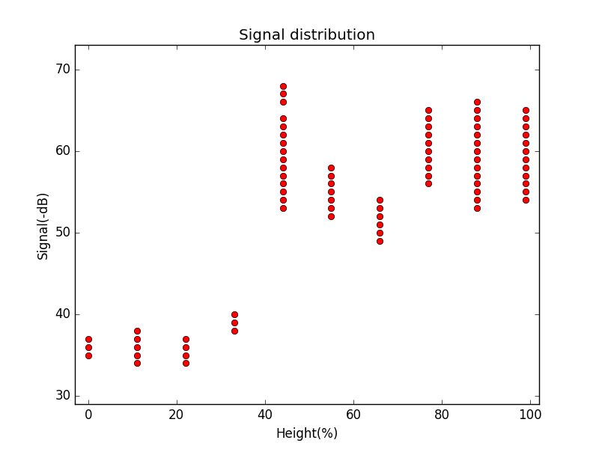
In Room (+ Noise/Interference )

Slide 25
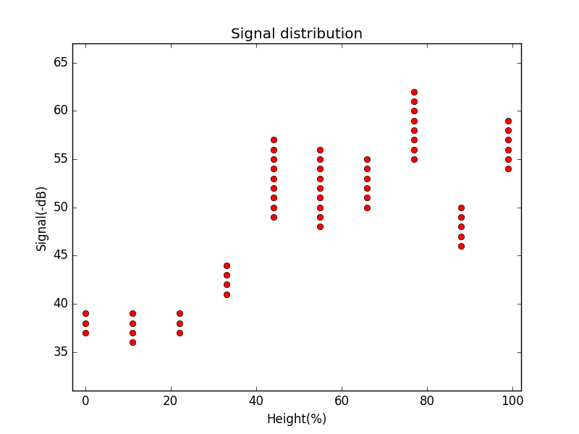
ON ground (- Noise/Interference )

Slide 26
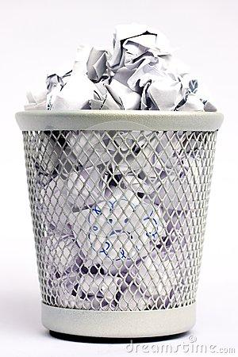
Paper

Slide 27
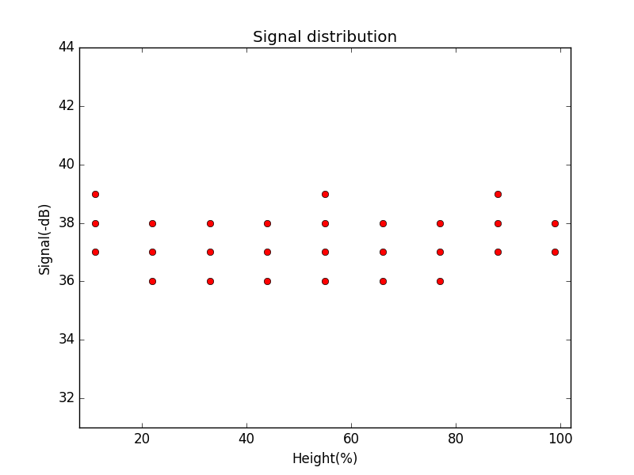

Slide 28
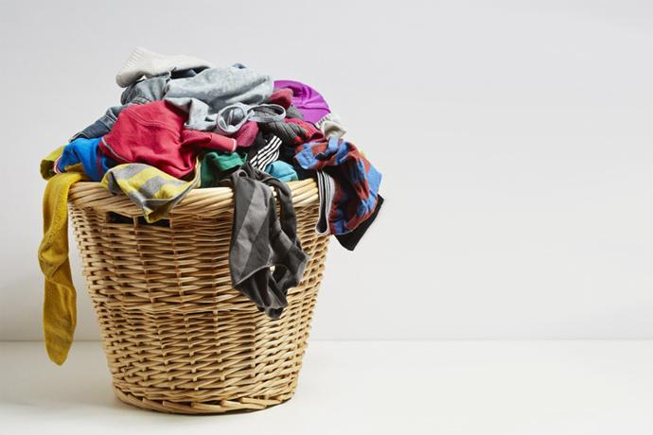
Clothes

Slide 29
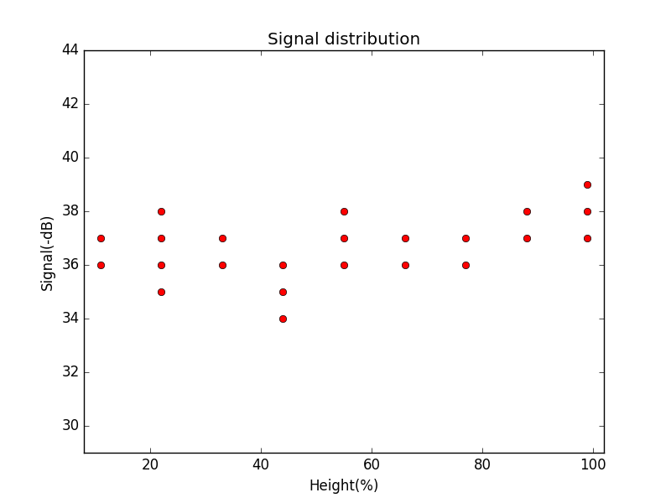

Slide 30
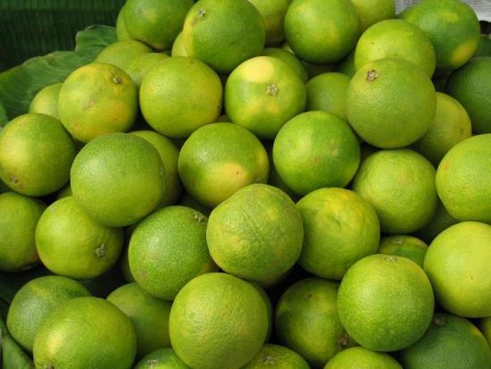
Mosambi - Sweet lime

Slide 31
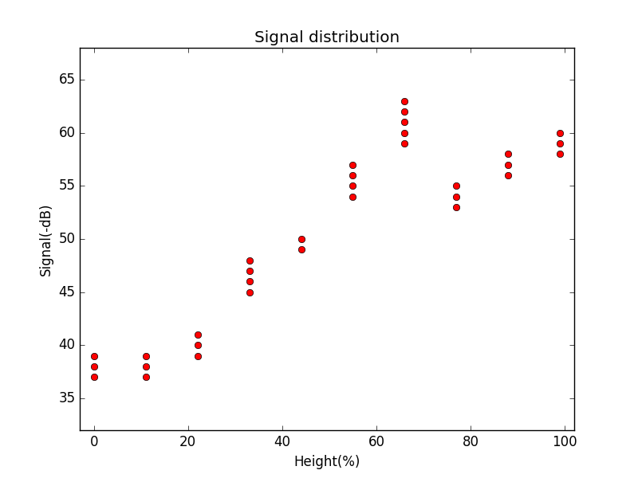

Slide 32
We’d some data,
Now what?

Slide 33
Classification - Artificial Neural Networks
We started with data collected for water and build up our Artificial Neural Network with H = 4,8,12,16.
We were able to get max 40% accuracy in predicting the height
That was below our expectations.

Slide 34
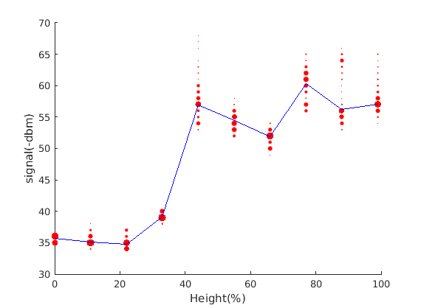
Water

Slide 35
So Did we succeed?

Slide 36
90%
We thought we were about to succeed and then we performed the experiment with metal.
With metal we got significant variation in wifi signals and this could have been a dead end to our experiment.

Slide 37
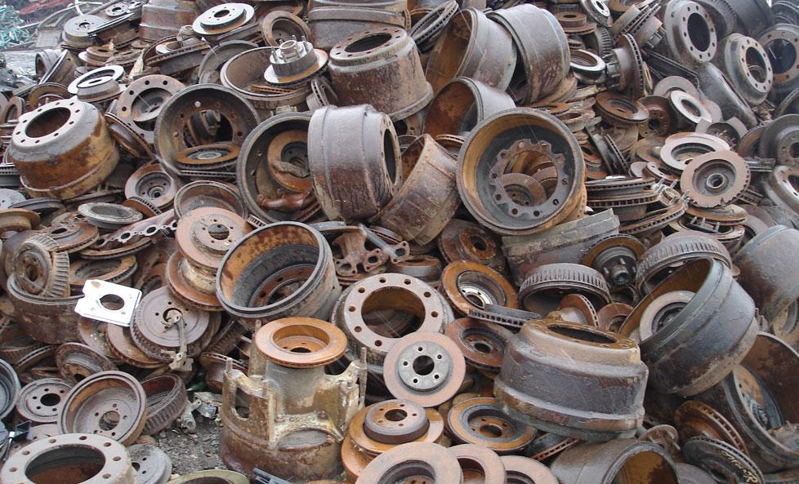
Metal

Slide 38
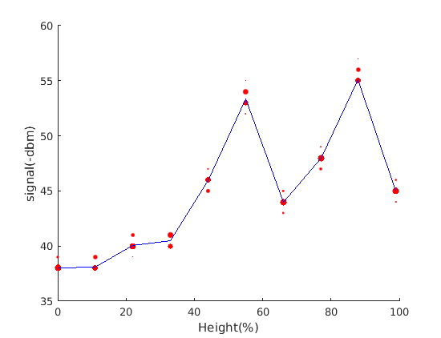
Metal

Slide 39
Experiments with arduino

Slide 40
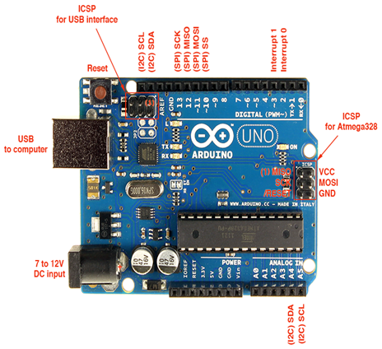
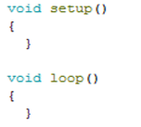




Some Basics of Arduino

Slide 41
Why do garbage bins smell so bad?

Slide 42
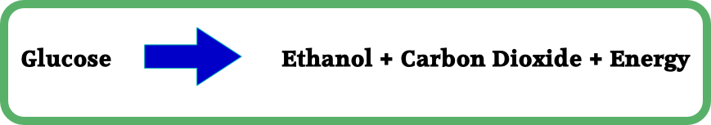
Principle behind operation
The basic principle of operation over here is as follows
The microorganisms act on garbage & decompose it to release energy for themselves, a lot like in humans, this energy leads to a raised temperature.

Slide 43
Temperature Sensor - LM355
There are certain sensors like DHT11, LM35, LM34 etc.
Out of which we chose LM355 because, this sensor gives the output in Kelvin so it can be easily converted to any other standard as per our choice.
The LM335 gives an output 10mV/Kelvin, meaning if it is reading 2.87 or 2870 mV, so the equivalent temperature is 287K and accordingly we can calculate other values also.

Slide 44
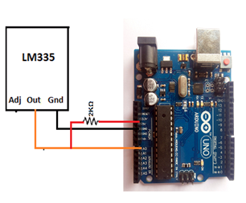
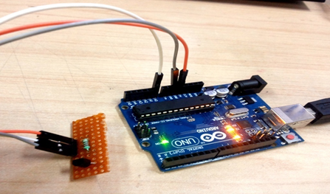
Interfacing LM 355 with arduino

Slide 45
Experimental Setup
To conduct this experiment we had 4 LM355 modules, because it was essential to maintain the same environmental conditions.
One each for ambient, inorganic & organic conditions because reading had to be taken simultaneously.
When organic matter is added temperature first drops slightly (water acts as coolant) then rises until it hits a steady state condition where the water cooling & the heating due to decomposition balances out.
This is when the reading is taken.

Slide 46
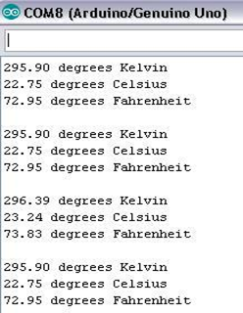
Output obtained
Ambient temperature reading.
Temperature reading for inorganic waste.
Temperature reading for organic waste
Temperature reading when emptied
All temperatures are steady state

Slide 47
Future Work

Slide 48
Exploring New Avenues
We are going to explore the effect on temperature a bit more, to find the relation between percentage of organic matter versus impact on temperature raise.
Additionally gas sensors that check CO₂ levels can be employed these should remain more or less constant for ambient conditions.
Since we aim to deploy our smart bin in IIT Ropar, we wish to make it economically & environmentally optimized.

Slide 49
Optimisation

Slide 50
Reducing Active Number of Bins to save energY
Intel Edison Nodes
Line of Sight
Smart Bin

Slide 51
Reducing Active Number of Bins to save energY
We aim to choose a cluster head so that minimum number of nodes are awake at a time and thus conserve energy.
The bin chosen would be such that its intersection with line of sight of other bins would be maximum.
In this way the other bins would have their nodes in sleep cycle and they would be asked to wake up by sending a wake up signal from the chosen bin’s node.

Slide 52
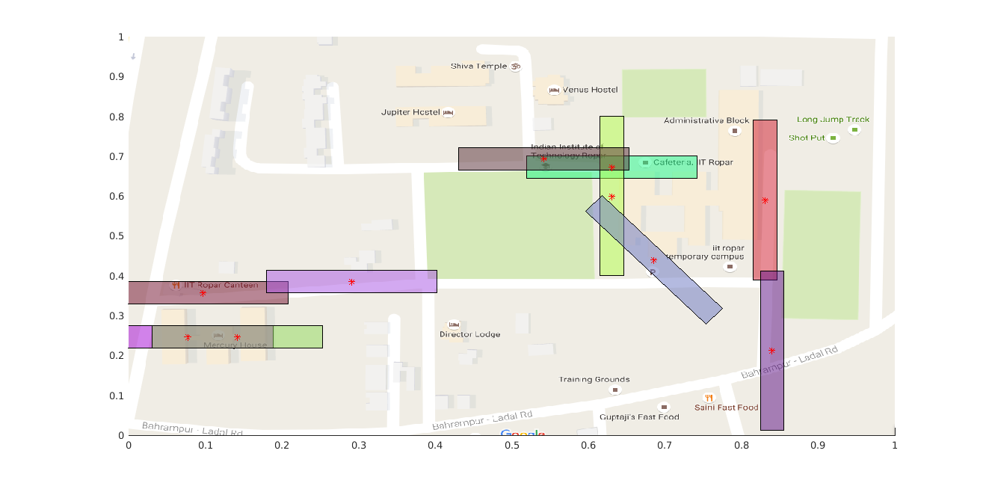
Suboptimal Connected Graph of Bins* at IIT-Ropar

Slide 53
References
Insung Hong, Sunghoi Park, Beomseok Lee, Jaekeun Lee, Daebeom Jeong, and Sehyun Park, “IoT-Based Smart Garbage System for Efficient Food Waste Management,” The Scientific World Journal, vol. 2014, Article ID 646953, 13 pages, 2014. doi:10.1155/2014/646953
Meghana K C and Dr. K R Nataraj, “IOT Based Intelligent Bin for Smart Cities,” International Journal on Recent and Innovation Trends in Computing and Communication Volume: 4 Issue: 5
S.S.Navghane, M.S.Killedar, Dr.V.M.Rohokale, “IoT Based Smart Garbage and Waste Collection Bin,” (IJARECE) Volume 5, Issue 5, May 2016

Slide 54
References...
http://akizukidenshi.com/download/ds/intel/edison-module_HG_331189-002.pdf
https://en.wikipedia.org/wiki/Intel_Edison

